Slide 1
Planned Contrasts for ANOVAs in R
PSY 652 Module 11
Gemma Wallace & Neil Yetz
Nov 13, 2019

Slide 2
What are planned contrasts and why are they useful?
Examine pairwise differences between groups
Pre-planned analyses reduce the need to correct for multiple comparisons
Conduct planned contrast tests after running the initial ANOVA

Slide 3


Step 1: Create your contrasts
Assigns a weight to each of the groups in your predictor variable
Weights should add up to zero
Assigning a weight of zero means that group will not be included in the contrast
Order corresponds to order of groups in predictor variable

Slide 4

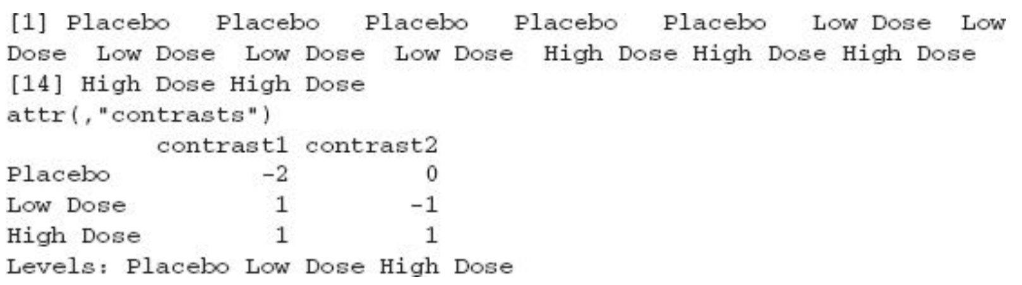
Step 2: Attach contrasts to your predictor variable
# View the variable to confirm that weights were properly assigned

Slide 5

Step 3: Run the ANOVA with contrasts
# The contrasts were attached to the predictor variable in the previous step
# The summary.lm function allows you to access the contrasts

Slide 6
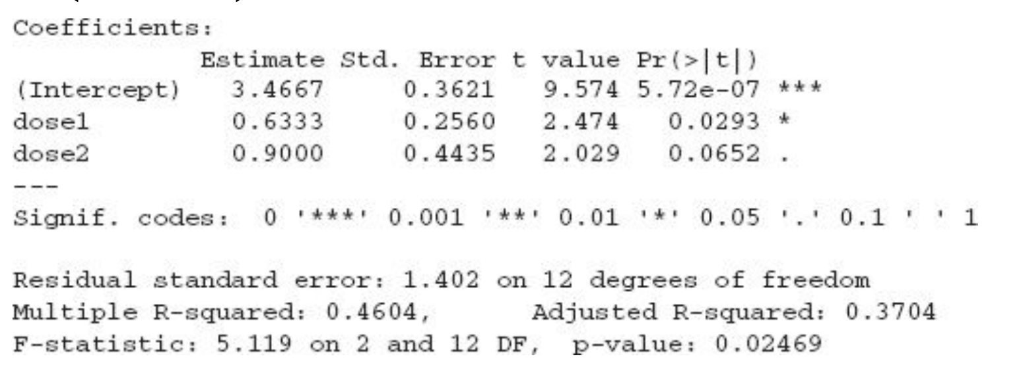
Step 3: Run the ANOVA with contrasts
NOTE: p values in planned contrasts are one-tailed, so divide by two in your interpretation
Intercept = grand mean of the outcome variable
Estimates = difference between the grand mean and the mean for the group weighted with a positive value (1 in this case)
p values = significance level of t-test for the contrast

Slide 7
References
The code examples in this presentation are from:
Field, A, Miles, J. & Field, Z. (2012). Discovering statistics using R. Los Angeles, CA: Sage Publications.

